Slide 1
Advanced Memory Handling in Compiler Construction

Slide 2

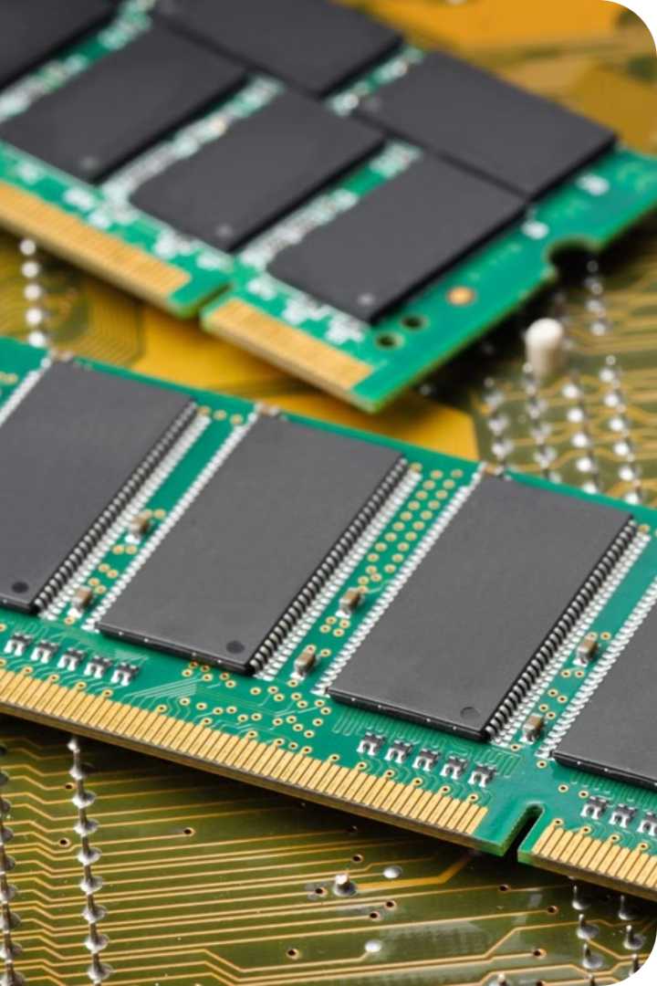
Introduction
Memory handling is a critical aspect of compiler construction, playing a vital role in determining the efficiency and performance of the compiled programs. In the context of advanced memory handling, the focus extends beyond basic memory allocation and deallocation to include sophisticated techniques that optimize memory usage, improve runtime efficiency, and ensure program correctness. In the rapidly evolving landscape of software development, the efficiency and performance of compiled programs are paramount.
ST

Slide 3
Importance of Advanced Memory Handling in Compiler Construction
Memory management in compilers involves allocating memory for variables, managing stack and heap memory, and ensuring efficient garbage collection. As programs grow in complexity and scale, the need for advanced memory management techniques becomes imperative. These techniques help in minimizing memory overhead, reducing fragmentation, and optimizing access patterns, which collectively enhance the overall performance of the application.

Slide 4

Memory Allocation Strategies
Static Allocation
Dynamic Allocation
Hybrid Approaches
Memory is allocated at compile-time, with a fixed size for each variable or data structure.
Memory is allocated and deallocated at runtime, allowing for more flexible memory usage.
Combining static and dynamic allocation to optimize memory usage and performance.

Slide 5
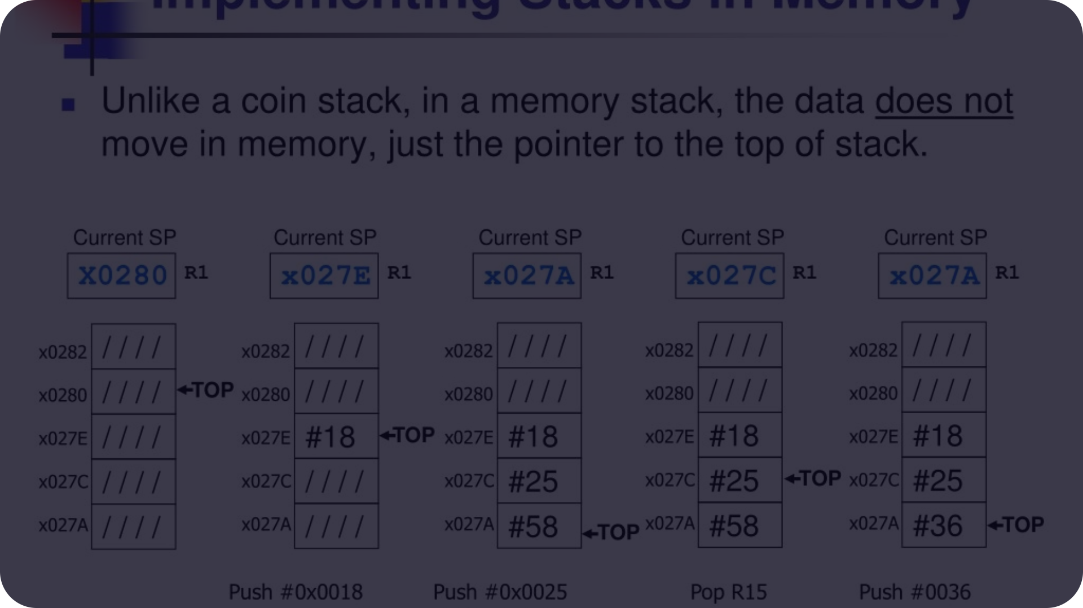
Stack-based Memory Management
Function Calls
1
The stack is used to manage memory for function call frames, storing local variables and return addresses.
2
Scope and Lifetime
Stack-based memory management ensures that variables have a well-defined scope and lifetime, simplifying memory allocation and deallocation.
Efficiency and Performance
3
Stack-based memory management is efficient, with fast allocation and deallocation of memory.

Slide 6

Heap-based Memory Management
Dynamic Memory Allocation
Variable Lifetimes
The heap allows for dynamic allocation and deallocation of memory at runtime, providing more flexibility than the stack.
Heap-based memory management supports variables with longer lifetimes that are not bound to function calls.
Complexity and Overhead
Heap-based memory management can be more complex and introduce additional overhead compared to stack-based approaches.

Slide 7

Garbage Collection
1
Automatic Memory Management
2
Reference Counting
Garbage collection automatically identifies and reclaims memory occupied by objects that are no longer in use.
Tracking the number of references to each object to determine when it can be safely deallocated.
3
Mark-and-Sweep
4
Generational Algorithms
Marking reachable objects and then sweeping away the unmarked objects to reclaim their memory.
Focusing on objects with shorter lifetimes to improve the efficiency of the garbage collection process.

Slide 8

Memory Optimization Techniques
Caching
Compression
Partitioning
Pooling
Leveraging caching mechanisms to reduce memory access times and improve performance.
Compressing data in memory to reduce the overall memory footprint.
Dividing memory into smaller, more manageable segments to optimize allocation and deallocation.
Maintaining a pool of pre-allocated memory blocks to reduce the overhead of dynamic allocation.

Slide 9
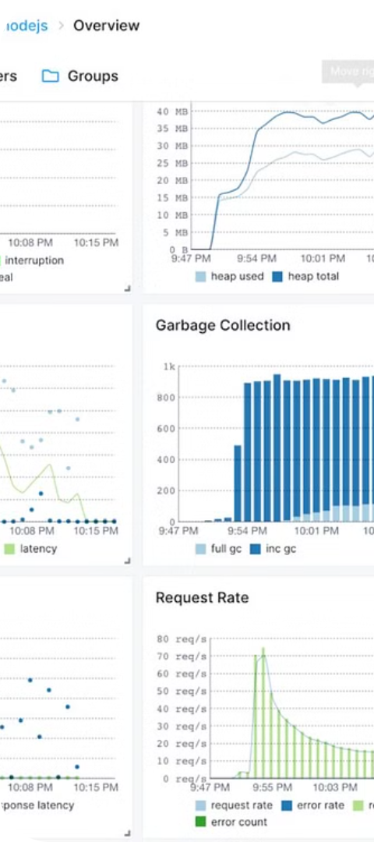



Memory Leaks and Debugging
Identify
Detecting memory leaks through profiling and monitoring tools.
Analyze
Investigating the root causes of memory leaks, such as improper memory management or reference counting issues.
Fix
Implementing solutions to prevent and fix memory leaks, such as manual memory deallocation or improved garbage collection strategies.

Slide 10
Conclusion and Best Practices
Use a combination of stack and heap-based memory management
Implement efficient garbage collection algorithms
Continuously monitor and optimize memory usage
Thoroughly test and debug for memory leaks
Memory management is a critical aspect of compiler design, requiring a deep understanding of allocation strategies, garbage collection, and optimization techniques. By following best practices, compilers can ensure efficient use of memory and deliver high-performance applications.

